Slide 1







Theme: Black Industry Report
Language: English
COVID-19
INSIGHTS
Tableau Dashboard
A Global Data Perspective
Topic: COVID-19 Insights Tableau Dashboard

Slide 2



01
Dashboard Overview
02
Key Metrics at a Glance
CONTENTS
03
Geographic Distribution
Table of Contents
04
Death Rate Analysis
05
Cases Over Time (2020–2024)
06
Vaccination by Continent
07
Data Quality & Limitations
08
Key Takeaways & Recommendations
02

Slide 3

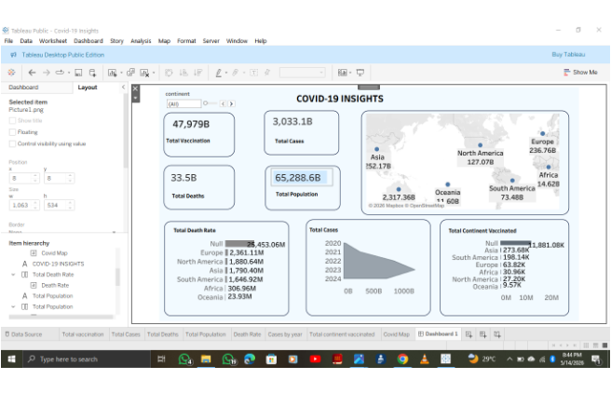
Dashboard Overview
Purpose
Provide a global overview of COVID-19 statistics across continents
Included views
Geographic map with bubble markers by continent
Death rate by continent (bar chart)
Total cases by year 2020–2024 (area chart)
Vaccination by continent (bar chart)
03

Slide 4

Key Metrics at a Glance
Total Vaccination
Total Cases
47,979B
3,033.1B
Total Deaths
Total Population
33.5B
65,288.6B
04

Slide 5






Geographic Distribution
Asia
North America
Europe
South America
Oceania
Impact distribution visualized via bubble markers
Africa
05

Slide 6
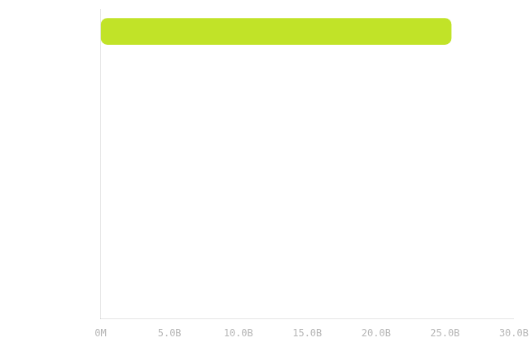


Death Rate by Continent
Primary Insight
The "Null" category represents the highest recorded death rate at 25,453.06M, indicating significant uncategorized data.
Continental Ranking
Among identified continents, Europe and North America show higher death rates compared to Oceania and Africa.
06

Slide 7
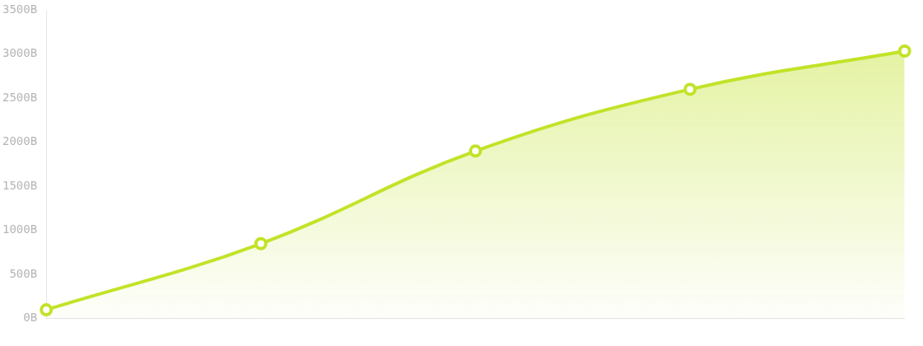
Total Cases by Year
steady accumulation, 2020–2024
07

Slide 8
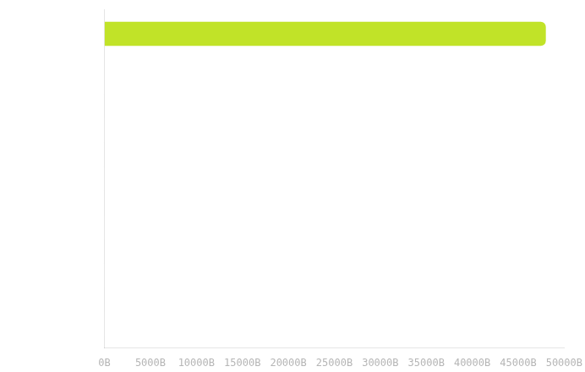



Total Continent Vaccinated
RANK 1
Null Category
Consistent with death rate metrics, uncategorized data remains the largest segment in global vaccination reporting.
RANK 2
Asia
Asia leads identified continents in total vaccination counts, followed by South America and Europe.
Global Distribution Trend
08

Slide 9





Key Takeaways and Recommendations
Figures appear scaled/aggregated (e.g., population shown as 65,288.6B) and may be from a practice/template dashboard; may not reflect real-world statistics
Key Takeaways
Recommendations
01
Dashboard provides global overview across continents via map + trend + ranked bars
Validate category mapping behind “Null” and clarify continent classification
02
“Null” appears as the highest category in death rate and vaccination charts
Verify units/scaling for headline metrics before executive decision-making
03
Total cases trend shows steady accumulation from 2020 to 2024
Use consistent definitions across cases, deaths, vaccinations, and population
09

Slide 10


Thank You
Q&A
COVID-19 INSIGHTS: A Global Data Perspective

